Slide 1

February 2019
Inside Sherpa – Digital Internship
Technology, Strategy & Architecture – TS&I
Work in Progress Module Tasks and Ideal Responses
Deloitte Virtual Intern

Slide 2
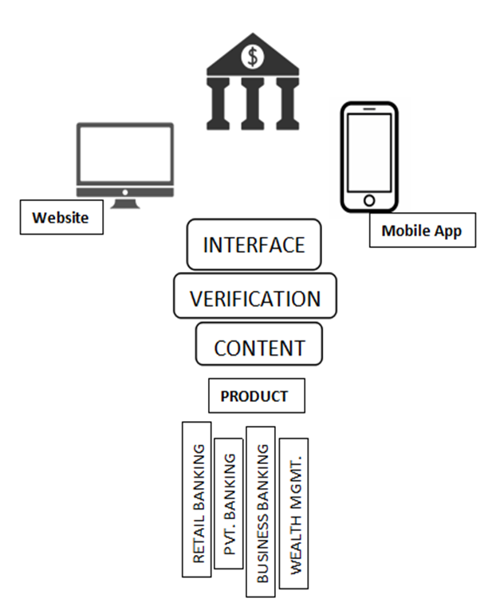
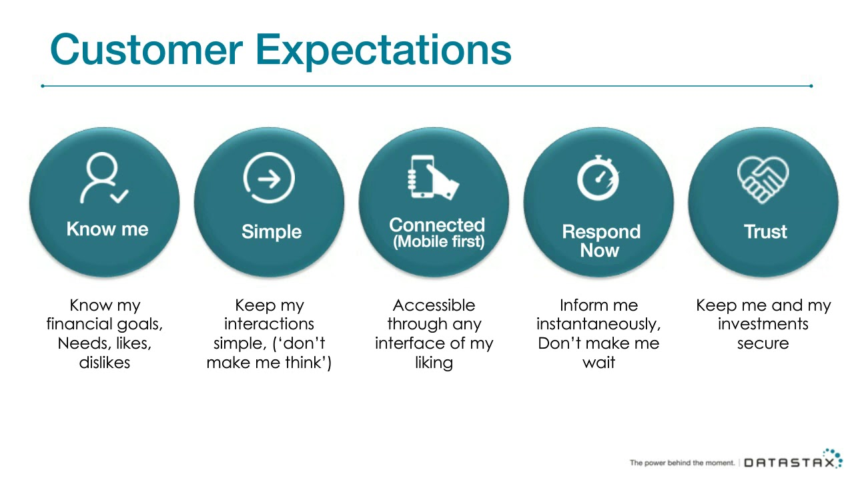
Client Discovery
Technology Architecture
Usability of the Solution

Slide 3
Client Discovery
Technology Delivery
Technology Framework and Compatibility
Cost – Effective
Security and authentication are key prioritizations
Strong database
Can alert and detect errors and avoid errors as well
Strong AI
Faster & Reliable
Automated
Branch Banking
Mobile Banking
ATM Channel of Banking
Mobile Banking or Phone Banking, Tele-Banking
Internet Banking, Online Banking, E-Banking

